Slide 1
COMP 2230
Week 7 - Wednesday

Slide 2
Last time
More on relations
Properties
Reflexive
Symmetric
Transitive
Started equivalence classes

Slide 3
Questions?

Slide 4
Assignment 3

Slide 5
Back to Equivalence Relations

Slide 6
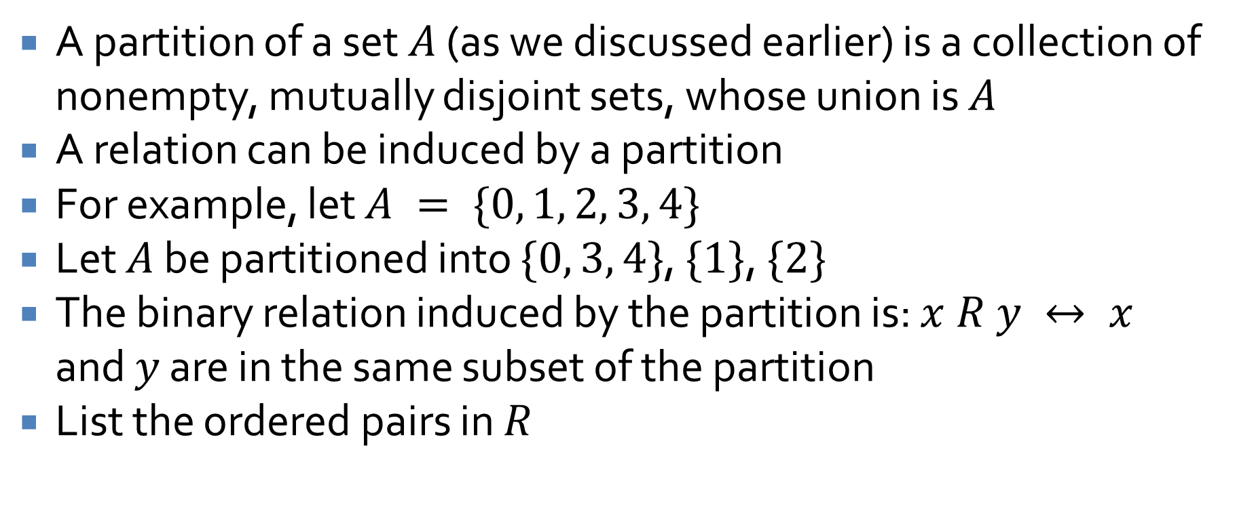
Partitions
A partition of a set $A$ (as we discussed earlier) is a collection of nonempty, mutually disjoint sets, whose union is $A$
A relation can be induced by a partition
For example, let $A = \{0, 1, 2, 3, 4\}$
Let $A$ be partitioned into $\{0, 3, 4\}$, $\{1\}$, $\{2\}$
The binary relation induced by the partition is: $x R y ↔ x$ and $y$ are in the same subset of the partition
List the ordered pairs in $R$

Slide 7
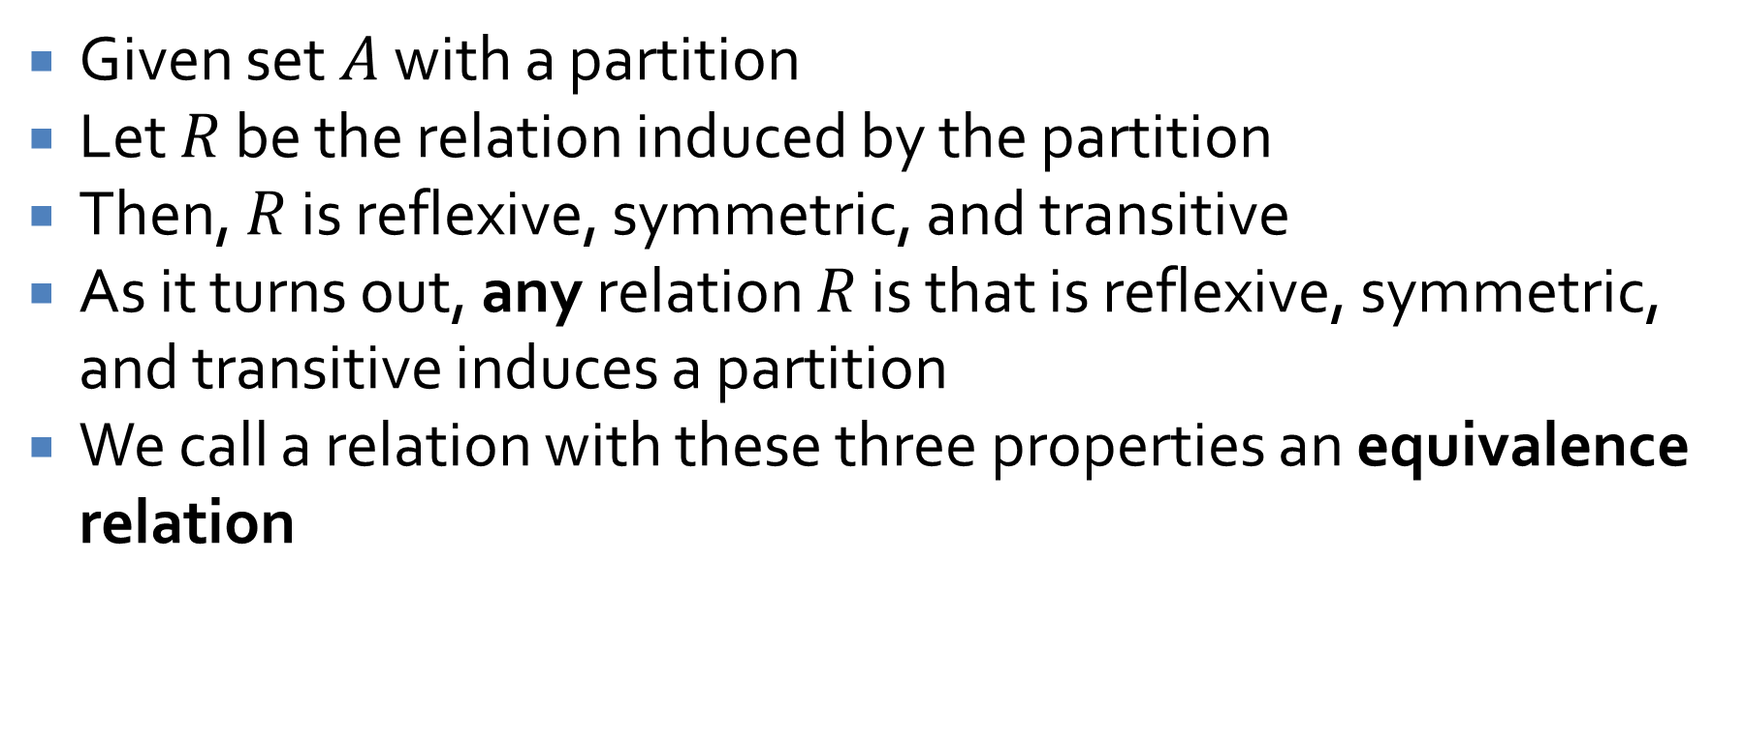
Equivalence relations
Given set $A$ with a partition
Let $R$ be the relation induced by the partition
Then, $R$ is reflexive, symmetric, and transitive
As it turns out, any relation $R$ is that is reflexive, symmetric, and transitive induces a partition
We call a relation with these three properties an equivalence relation

Slide 8
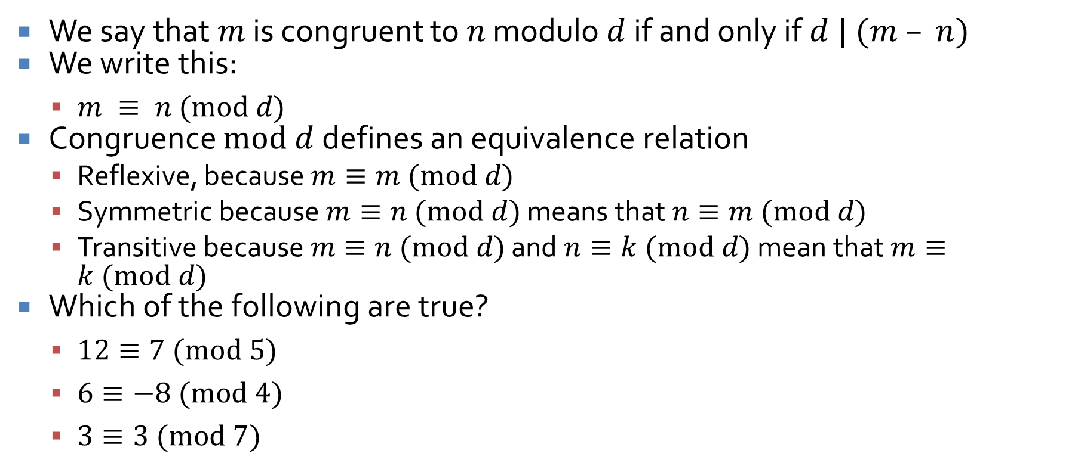
Congruences
We say that $m$ is congruent to $n$ modulo $d$ if and only if $d | (m – n)$
We write this:
$m ≡ n (mod d)$
Congruence $mod d$ defines an equivalence relation
Reflexive, because $m≡m (mod d)$
Symmetric because $m≡n (mod d)$ means that $n≡m (mod d)$
Transitive because $m≡n (mod d)$ and $n≡k (mod d)$ mean that $m≡k (mod d)$
Which of the following are true?
$12≡7 (mod 5)$
$6≡−8 (mod 4)$
$3≡3 (mod 7)$

Slide 9
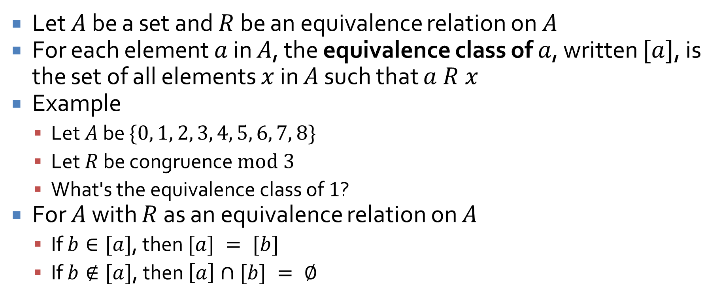
Equivalence classes
Let $A$ be a set and $R$ be an equivalence relation on $A$
For each element $a$ in $A$, the equivalence class of $a$, written $[a]$, is the set of all elements $x$ in $A$ such that $a R x$
Example
Let $A$ be $\{0, 1, 2, 3, 4, 5, 6, 7, 8\}$
Let $R$ be congruence $mod 3$
What's the equivalence class of $1$?
For $A$ with $R$ as an equivalence relation on $A$
If $b∈[a]$, then $[a] = [b]$
If $b∉[a]$, then $\left[a\right]∩[b] = ∅$

Slide 10
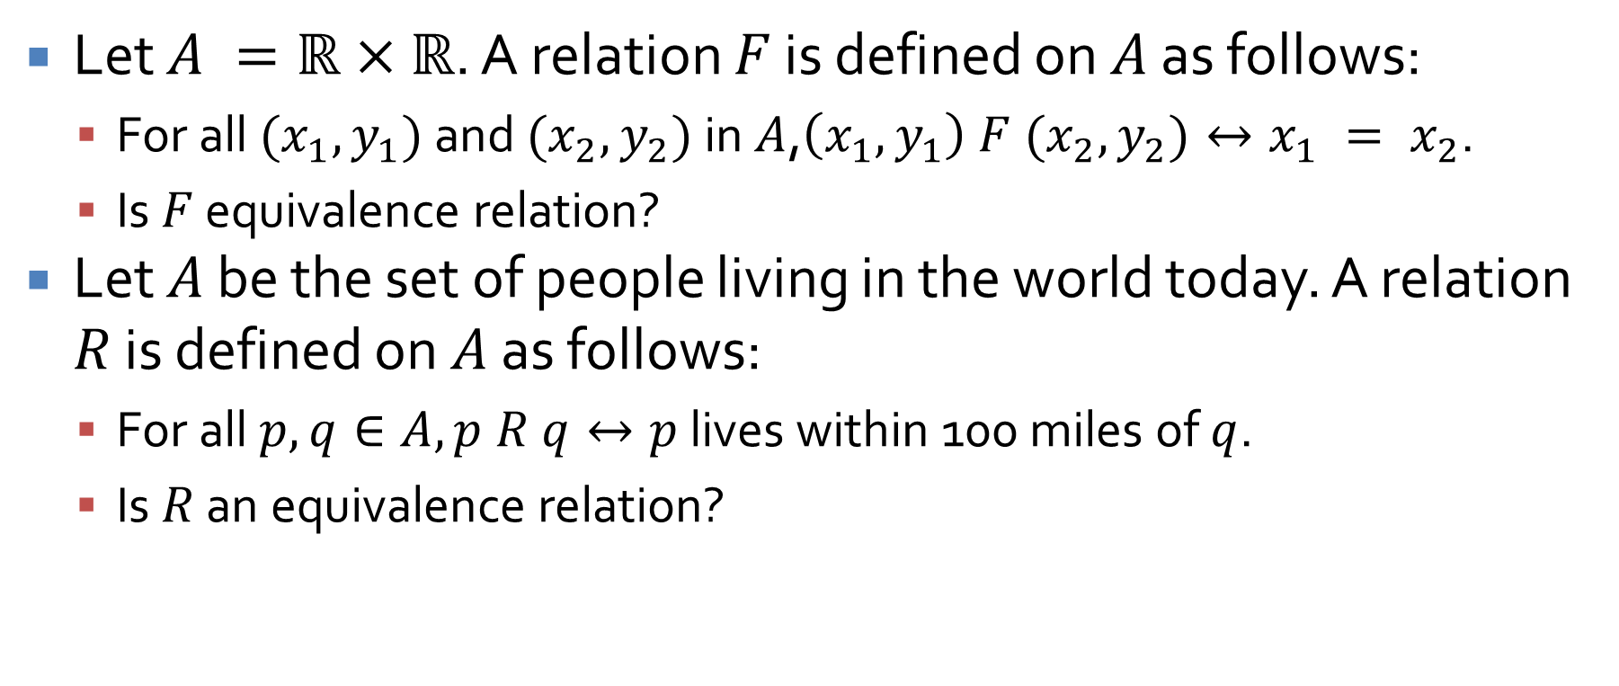
Equivalence relation practice
Let $A =ℝ×ℝ$. A relation $F$ is defined on $A$ as follows:
For all $(x_{1}, y_{1})$ and $(x_{2}, y_{2})$ in $A$,$\left(x_{1}, y_{1}\right) F (x_{2}, y_{2})↔x_{1} = x_{2}$.
Is $F$ equivalence relation?
Let $A$ be the set of people living in the world today. A relation $R$ is defined on $A$ as follows:
For all $p, q∈A, p R q↔p$ lives within 100 miles of $q$.
Is $R$ an equivalence relation?

Slide 11
Modular Arithmetic

Slide 12
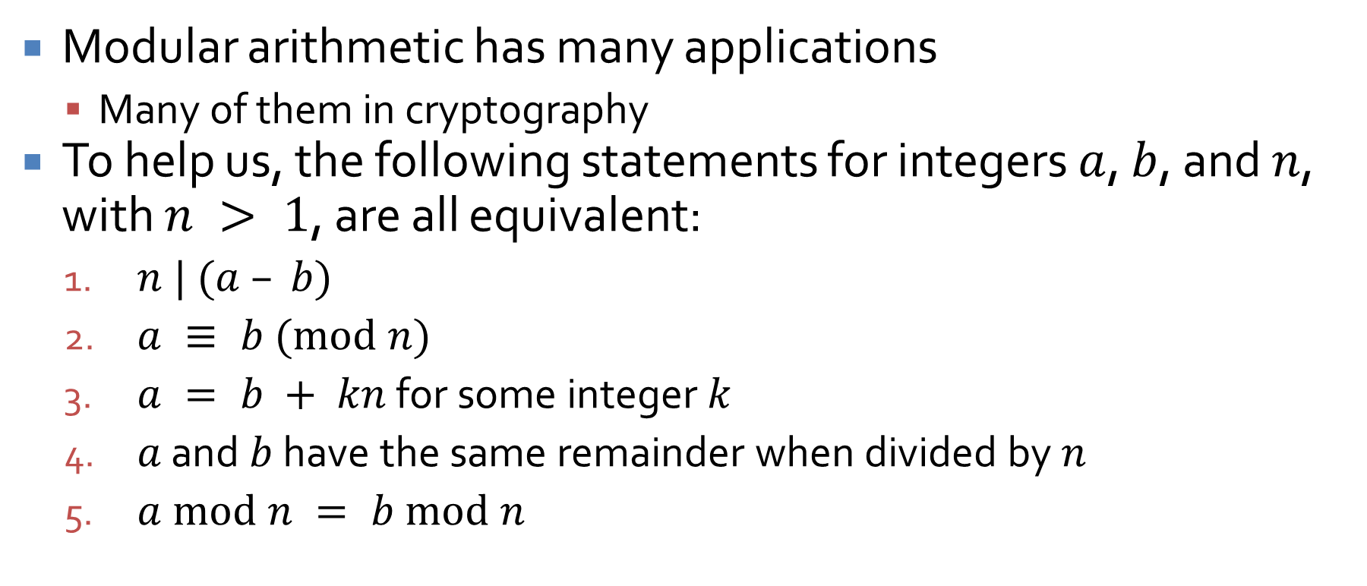
Modular arithmetic
Modular arithmetic has many applications
Many of them in cryptography
To help us, the following statements for integers $a$, $b$, and $n$, with $n > 1$, are all equivalent:
$n | (a – b)$
$a ≡ b (mod n)$
$a = b + kn$ for some integer $k$
$a$ and $b$ have the same remainder when divided by $n$
$a mod n = b mod n$

Slide 13
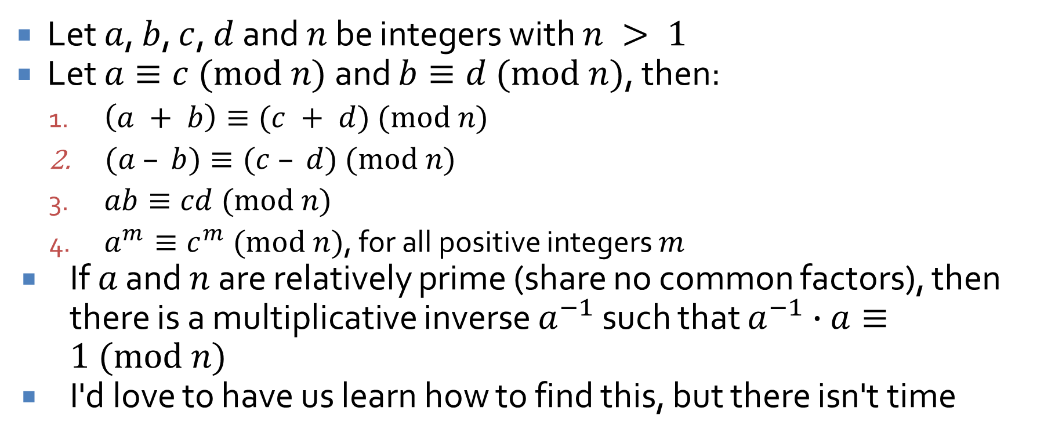
Rules of modular arithmetic
Let $a$, $b$, $c$, $d$ and $n$ be integers with $n > 1$
Let $a≡c (mod n)$ and $b≡d (mod n)$, then:
$\left(a + b\right)≡(c + d) (mod n)$
$(a – b)≡(c – d) (mod n)$
$ab≡cd (mod n)$
$a^{m}≡c^{m} (mod n)$, for all positive integers $m$
If $a$ and $n$ are relatively prime (share no common factors), then there is a multiplicative inverse $a^{−1}$ such that $a^{−1}∙a≡1 (mod n)$
I'd love to have us learn how to find this, but there isn't time

Slide 14
Partial Orders

Slide 15
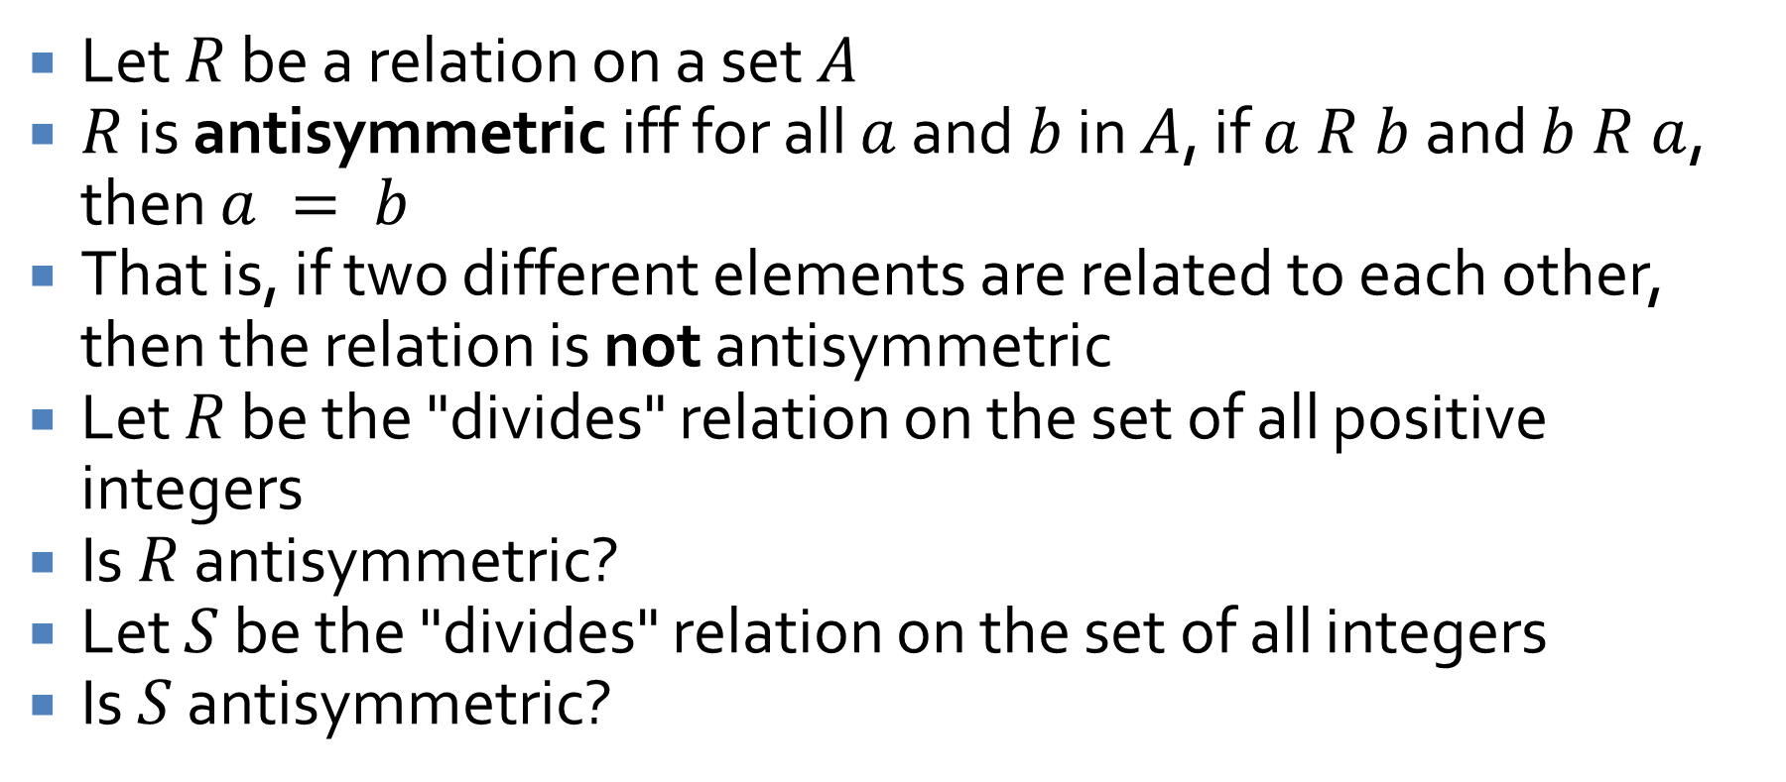
Antisymmetry
Let $R$ be a relation on a set $A$
$R$ is antisymmetric iff for all $a$ and $b$ in $A$, if $a R b$ and $b R a$, then $a = b$
That is, if two different elements are related to each other, then the relation is not antisymmetric
Let $R$ be the "divides" relation on the set of all positive integers
Is $R$ antisymmetric?
Let $S$ be the "divides" relation on the set of all integers
Is $S$ antisymmetric?

Slide 16
Partial orders
A relation that is reflexive, antisymmetric, and transitive is called a partial order
The subset relation is a partial order
Show it's reflexive
Show it's antisymmetric
Show it's transitive
The less than or equal to relation is a partial order
Show it's reflexive
Show it's antisymmetric
Show it's transitive

Slide 17
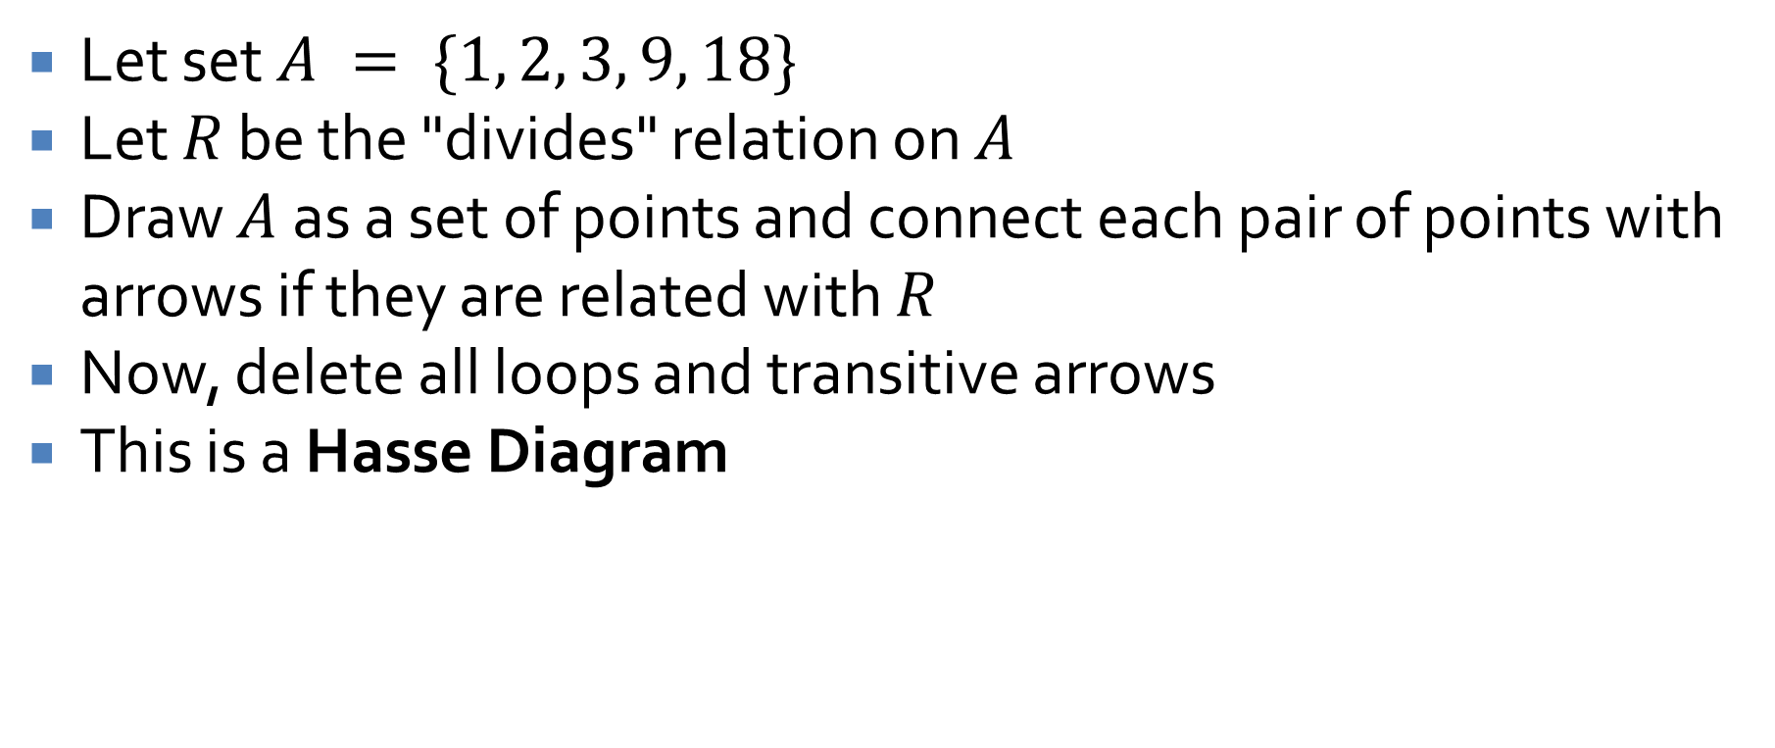
Hasse Diagrams
Let set $A = \{1, 2, 3, 9, 18\}$
Let $R$ be the "divides" relation on $A$
Draw $A$ as a set of points and connect each pair of points with arrows if they are related with $R$
Now, delete all loops and transitive arrows
This is a Hasse Diagram

Slide 18
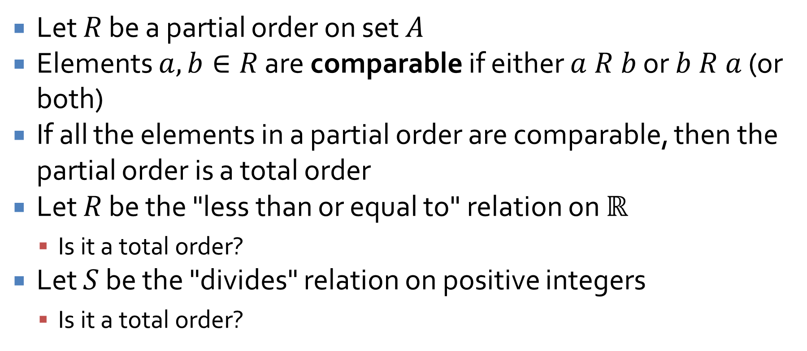
Total orders
Let $R$ be a partial order on set $A$
Elements $a,b∈R$ are comparable if either $a R b$ or $b R a$ (or both)
If all the elements in a partial order are comparable, then the partial order is a total order
Let $R$ be the "less than or equal to" relation on $ℝ$
Is it a total order?
Let $S$ be the "divides" relation on positive integers
Is it a total order?

Slide 19
Review

Slide 20
Indirect Proofs

Slide 21
Proof by contradiction
In a proof by contradiction, you begin by assuming the negation of the conclusion
Then, you show that doing so leads to a logical impossibility
Thus, the assumption must be false and the conclusion true

Slide 22
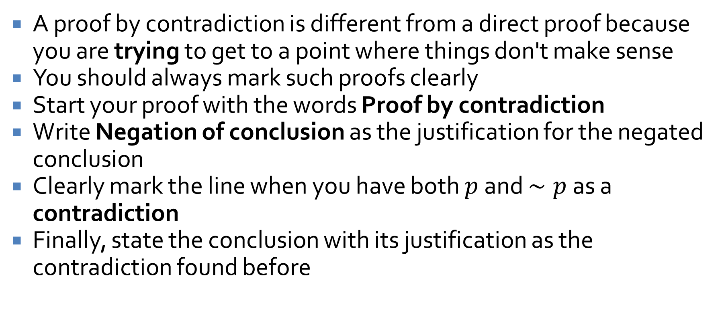
Contradiction formatting
A proof by contradiction is different from a direct proof because you are trying to get to a point where things don't make sense
You should always mark such proofs clearly
Start your proof with the words Proof by contradiction
Write Negation of conclusion as the justification for the negated conclusion
Clearly mark the line when you have both $p$ and $∼p$ as a contradiction
Finally, state the conclusion with its justification as the contradiction found before

Slide 23
Sequences and Induction

Slide 24
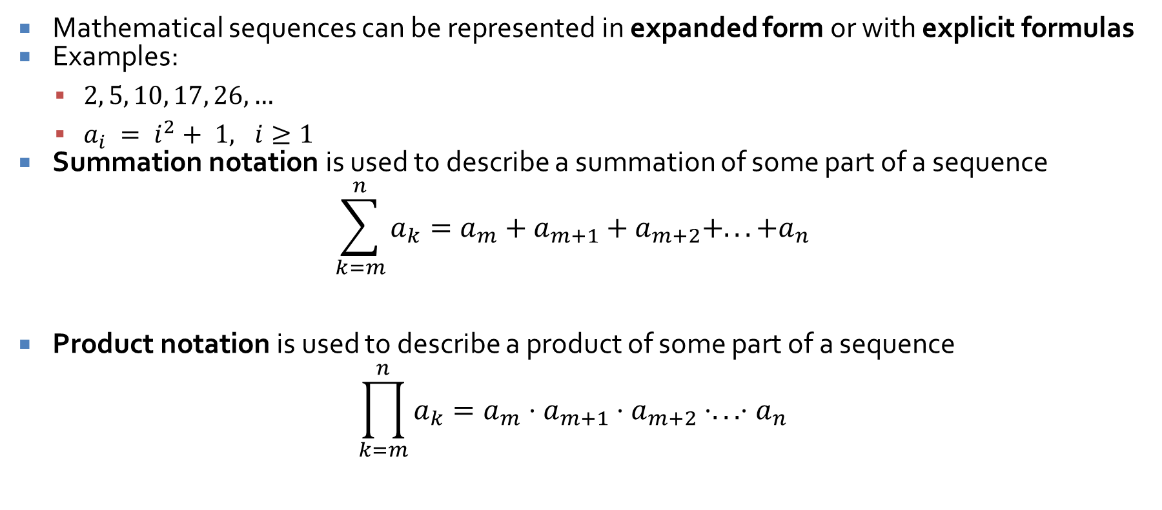
Sequences
Mathematical sequences can be represented in expanded form or with explicit formulas
Examples:
$2, 5, 10, 17, 26, …$
$a_{i} = i^{2}+ 1, i≥1$
Summation notation is used to describe a summation of some part of a sequence
$$\sum_{k=m}^{n}{a_{k}}=a_{m}+a_{m+1}+a_{m+2}+...+a_{n}$$
Product notation is used to describe a product of some part of a sequence
$$\prod_{k=m}^{n}{a_{k}}=a_{m}⋅a_{m+1}⋅a_{m+2}⋅...⋅a_{n}$$

Slide 25
Proof by mathematical induction
To prove a statement of the following form:
$n  ℤ$, where $n  a$, property $P(n)$ is true
Use the following steps:
Basis Step: Show that the property is true for $P(a)$
Induction Step:
Suppose that the property is true for some $n = k$, where $k  ℤ, k  a$
Now, show that, with that assumption, the property is also true for $k + 1$

Slide 26

Mathematical induction example
Prove that, for all integers $n≥1$,
$$\frac{\sum_{i=1}^{n}{2i−1}}{\sum_{i=1}^{n}{2n+2i−1}}=\frac{1}{3}$$

Slide 27
Recursion
Using recursive definitions to generate sequences
Writing a recursive definition based on a sequence
Using mathematical induction to show that a recursive definition and an explicit definition are equivalent

Slide 28
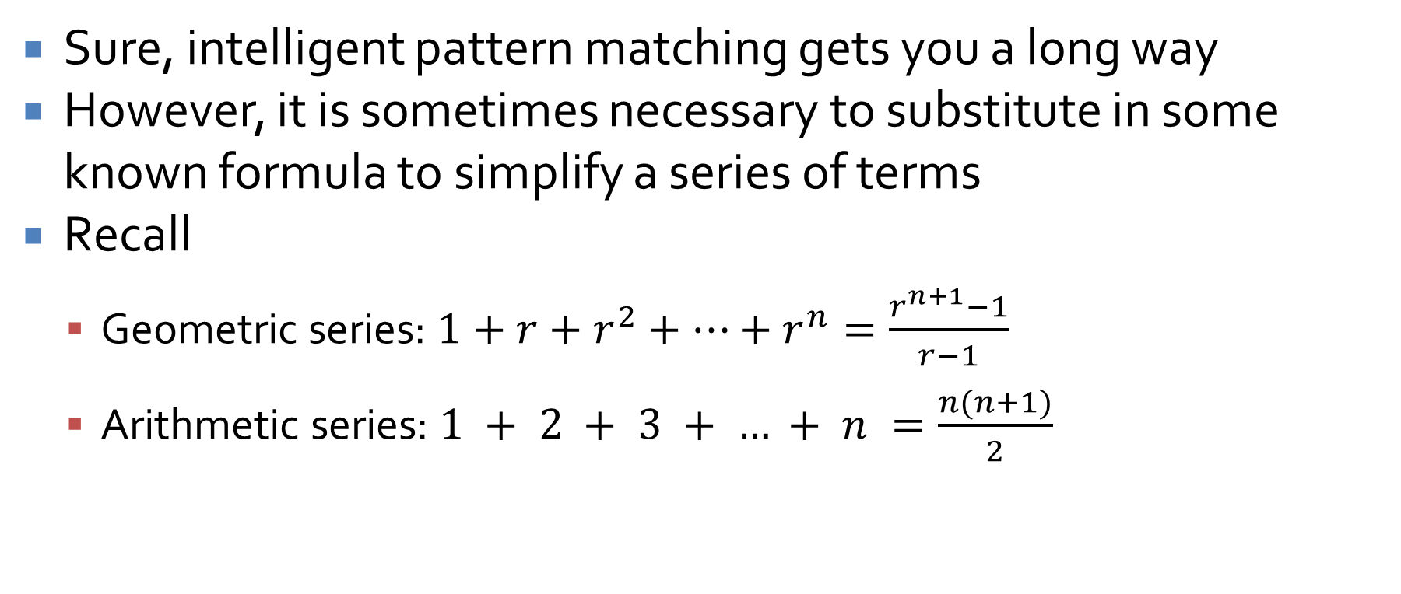
Employing outside formulas
Sure, intelligent pattern matching gets you a long way
However, it is sometimes necessary to substitute in some known formula to simplify a series of terms
Recall
Geometric series: $1+r+r^{2}+…+r^{n}=\frac{r^{n+1}−1}{r−1}$
Arithmetic series: $1 + 2 + 3 + … + n =\frac{n(n+1)}{2}$

Slide 29
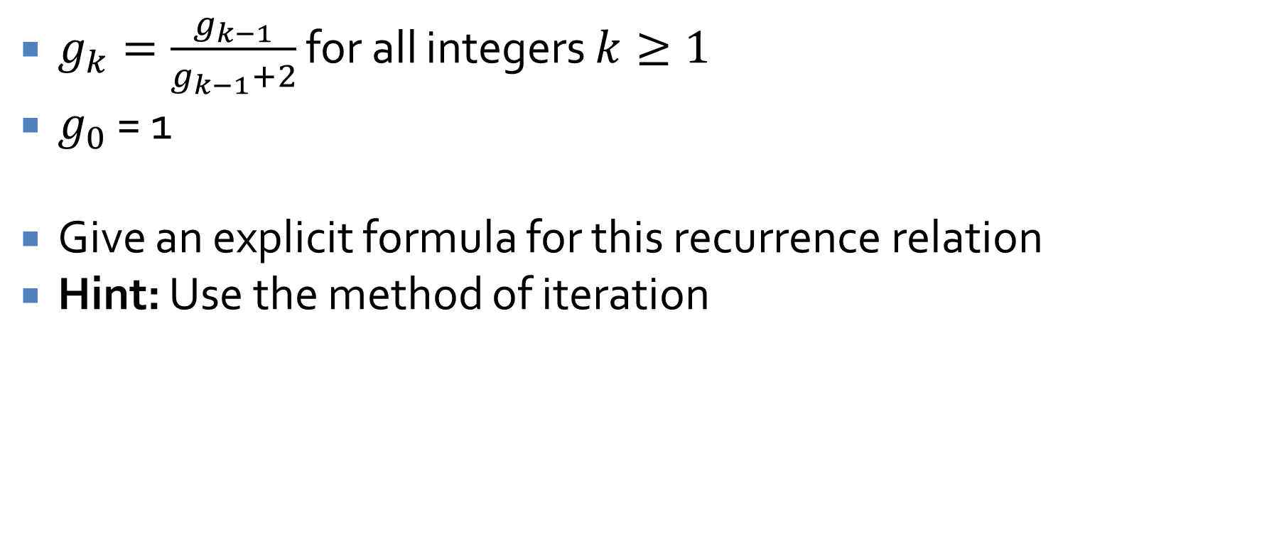
Recursive sequence example
$g_{k}=\frac{g_{k−1}}{g_{k−1}+2}$ for all integers $k≥1$
$g_{0}$ = 1
Give an explicit formula for this recurrence relation
Hint: Use the method of iteration

Slide 30
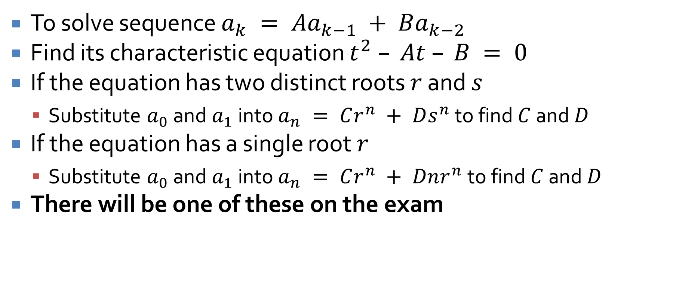
Solving second order linear homogeneous recurrence relations with constant coefficients
To solve sequence $a_{k} = Aa_{k−1} + Ba_{k−2}$
Find its characteristic equation $t^{2} – At – B = 0$
If the equation has two distinct roots $r$ and $s$
Substitute $a_{0}$ and $a_{1}$ into $a_{n} = Cr^{n} + Ds^{n}$ to find $C$ and $D$
If the equation has a single root $r$
Substitute $a_{0}$ and $a_{1}$ into $a_{n} = Cr^{n} + Dnr^{n}$ to find $C$ and $D$
There will be one of these on the exam

Slide 31
Set Theory

Slide 32
Set theory basics
Defining finite and infinite sets
Definitions of:
Subset
Proper subset
Set equality
Set operations:
Union
Intersection
Difference
Complement
The empty set
Partitions
Cartesian product

Slide 33
Set theory proofs
Proving a subset relation
Element method: Assume an element is in one set and show that it must be in the other set
Algebraic laws of set theory: Using the algebraic laws of set theory (given on the next slide), we can show that two sets are equal
Disproving a universal statement requires a counterexample with specific sets

Slide 34
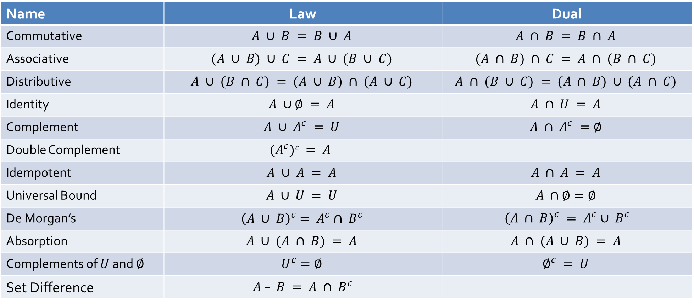
Laws of set theory
Name | Law | Dual
Commutative | $$A ∪ B = B ∪ A$$ | $$A ∩ B = B ∩ A$$
Associative | $$(A ∪ B) ∪ C = A ∪ (B ∪ C)$$ | $$(A ∩ B) ∩ C = A ∩ (B ∩ C)$$
Distributive | $$A ∪ (B ∩ C) = (A ∪ B) ∩ (A ∪ C)$$ | $$A ∩ (B ∪ C) = (A ∩ B) ∪ (A ∩ C)$$
Identity | $$A ∪∅ = A$$ | $$A ∩ U = A$$
Complement | $$A ∪ A^{c} = U$$ | $$A ∩ A^{c} =∅$$
Double Complement | $$(A^{c})c = A$$
Idempotent | $$A ∪ A = A$$ | $$A ∩ A = A$$
Universal Bound | $$A ∪ U = U$$ | $$A ∩∅=∅$$
De Morgan’s | $${\left(A ∪ B\right)}^{c}= A^{c}∩ B^{c}$$ | ${\left(A ∩ B\right)}^{c} = A^{c}∪ B^{c}$
Absorption | $$A ∪ (A ∩ B) = A$$ | $$A ∩ (A ∪ B) = A$$
Complements of $U$ and $∅$ | $$U^{c}=∅$$ | $$∅^{c} = U$$
Set Difference | $A – B = A ∩ B^{c}$

Slide 35

Set theory proof example
Use the element method to prove the following:
For all sets $A$, $B$, and $C$, if $A⊆B$ then $A∩C⊆B∩C$

Slide 36
Russell's paradox
It is possible to give a description for a set which describes a set that does not actually exist
For a well-defined set, we should be able to say whether or not a given element is or is not a member
If we can find an element that must be in a specific set and must not be in a specific set, that set is not well defined
Watch out for definitions that are logically inconsistent!

Slide 37
Functions
One-to-one (injective) functions
Onto (surjective) functions
If a function is both one-to-one and onto, we call it bijective

Slide 38
Cardinality
Cardinality is the number of things in a set
It is reflexive, symmetric, and transitive
Two sets have the same cardinality if a bijective function maps every element in one to an element in the other
Any set with the same cardinality as positive integers is called countably infinite

Slide 39
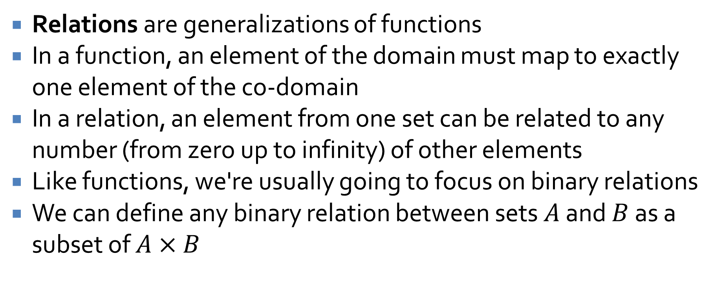
Relations
Relations are generalizations of functions
In a function, an element of the domain must map to exactly one element of the co-domain
In a relation, an element from one set can be related to any number (from zero up to infinity) of other elements
Like functions, we're usually going to focus on binary relations
We can define any binary relation between sets $A$ and $B$ as a subset of $A×B$

Slide 40
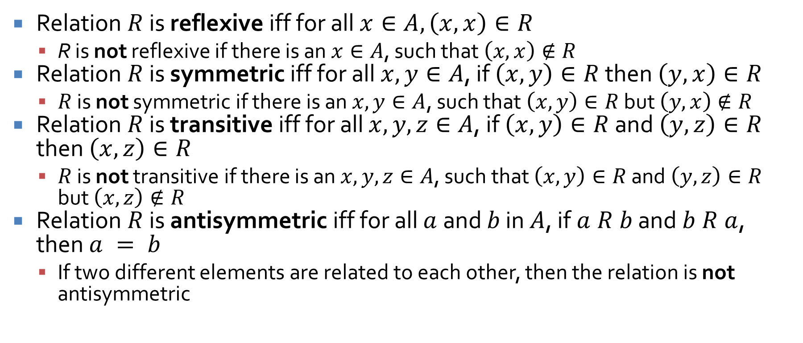
Properties
Relation $R$ is reflexive iff for all $x∈A, \left(x, x\right)∈R$
R is not reflexive if there is an $x∈A$, such that $\left(x, x\right)∉R$
Relation $R$ is symmetric iff for all $x, y∈A$, if $\left(x, y\right)∈R$ then $\left(y, x\right)∈R$
$R$ is not symmetric if there is an $x, y∈A$, such that $\left(x, y\right)∈R$ but $\left(y, x\right)∉R$
Relation $R$ is transitive iff for all $x, y, z∈A$, if $\left(x, y\right)∈R$ and $\left(y, z\right)∈R$ then $\left(x, z\right)∈R$
$R$ is not transitive if there is an $x, y, z∈A$, such that $\left(x, y\right)∈R$ and $\left(y, z\right)∈R$ but $\left(x, z\right)∉R$
Relation $R$ is antisymmetric iff for all $a$ and $b$ in $A$, if $a R b$ and $b R a$, then $a = b$
If two different elements are related to each other, then the relation is not antisymmetric

Slide 41
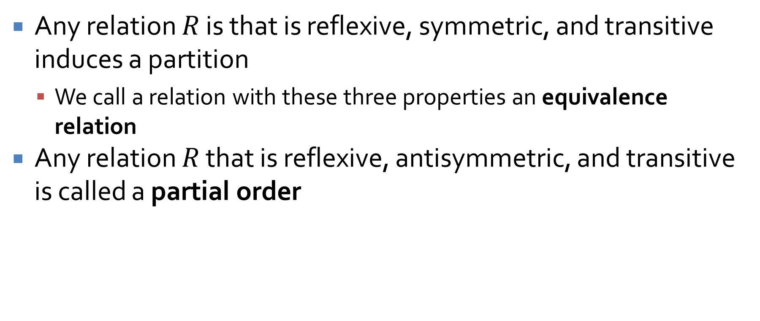
Kinds of relations
Any relation $R$ is that is reflexive, symmetric, and transitive induces a partition
We call a relation with these three properties an equivalence relation
Any relation $R$ that is reflexive, antisymmetric, and transitive is called a partial order

Slide 42
Upcoming

Slide 43
Next time…
Exam 2!

Slide 44
Reminders
Work on Assignment 3
Due Friday
No office hours on Wednesday, Thursday, or Friday
No class on Friday
Study for Exam 2
Next Monday!

